Slide 1
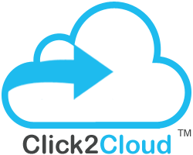
Analysis on API/SDK Implementation
Baidu has 737 Interfaces available which are less as compare to Alibaba’s 956 Interfaces and Huawei’s 1395 Interfaces.
Baidu has 718 API available which are less as compare to Alibaba’s 947 and Huawei’s 1146 APIs.
Baidu has Implemented 330 SDK’s which are less as compare to Alibaba’s 741 and Huawei’s 662.
Baidu has implemented SDK for only 46% of APIs where as Alibaba, Huawei has implemented 79% and 58% of SDK respectively.
Baidu has lot of scope for SDK implementation as compare to other cloud providers.
Baidu consist of:
718 - APIs
330 - SDK’s
available for the respective interfaces
Whereas other cloud providers consists of :
Huawei - 1146 APIs and 662 SDK’s
Alibaba - 947 APIs and 741 SDK’s
Suggestions & Recommendations
There is scope of SDK implementation for 388 more SDK’s in Baidu which is 55% compare to the APIs.

Slide 2
Statistics for Ansible implementation: Alibaba Vs AWS Vs Baidu Vs Huawei Vs JD Cloud Vs Tencent Vs U Cloud
Column 1 – Total Cloud Services
Column 2 - Total APIs Available for developers
Column 3 – Total Implemented Ansible
Analysis on Ansible Implementation
API required for Baidu are more as compare to AWS, Alibaba and Huawei.
Baidu still need to develop 737(737-0) Workbench calls (Interfaces).
Baidu is lagging to provide 737( 737-0) Ansible Implementation in market.
Alibaba with 37 and AWS with 349 Ansible Implementation is way ahead of the Baidu’s 0.
Baidu has converted 0% of their Workbench call (interfaces) into Ansible where as Alibaba and AWS has converted 4%, 20% API calls respectively.
Ansible Implementation Statistics
✓
As per the analysis report
Scope in current phase:- Ansible Implementation for 737 (737-0) Workbench calls (interfaces)

Slide 3






Analysis on Chef Implementation
AS YOU CAN SEE IN THE STATISTICS REPORT
Statistics of Chef implemented on various interfaces of available services:
Baidu consist of:
48 - Services
718 - APIs
available for the respective interfaces
Whereas other cloud providers consists of :
AWS - 78 services
Huawei - 91 services
Alibaba - 32 services resp.
38
AS PER THE STATISTICS REPORTS BELOW
11
0
SUGGESTIONS
RECOMMENDATIONS
Baidu has great scope for Chef implementation for its available services such as Computing, Networking, Database, Storage and CDN etc.
Baidu still has the scope to develop service actions (Interfaces).
Chef implementation for primary interfaces such as Elastic compute service (ECS), Virtual Private Cloud (VPC), Elastic IP’s (EIP) should be done.
Statistics for Chef Implementation

Slide 4
Analysis on Terraform Implementation
AS WE CAN SEE IN THE GIVEN STATISTICS
AWS implemented Terraform on 255 interfaces.
Alibaba implemented Terraform on 198 interfaces.
Huawei implemented Terraform on 187 interfaces.
Baidu’s 718 APIs need Terraform implementation.
SUGGESTIONS
Baidu can take this as a reference and prioritise the services they need to focus on for Terraform implementation.
For Baidu there is full scope to implement Terraform for 718 APIs.
RECOMMENDATIONS
Terraform implementations for the dominant services with interfaces available with respective API such as ECS, Disk, Container service, RDS, Cloud Hosting, VPC etc. should be done.

Slide 5
Migration Studio Readiness
Migration Studio supports Cloud to Cloud, Virtual to Cloud, Storage to Cloud, Application to Cloud, Database to Cloud migration.
Migration Services such as Cloud to Cloud and Virtual to Cloud are not supported by Baidu. For migration studio readiness Baidu needs to expose APIs for services such as IMS etc.
Database Services like MSSQL, MySQL, PostgreSQL can be migrated to Baidu cloud.
Suggestions and Recommendations :
Baidu supports Storage to Cloud, Application to Cloud and Database to Cloud Services.
In Database to Cloud Migration, there is scope for MSSQL, MySQL and PostgreSQL database migration on Baidu cloud.

Slide 6
C2C - Container Services Shift’M, DockM Support
AS WE CAN SEE IN THE GIVEN STATISTICS
C2C tools for container services provides support for Alibaba cloud.
C2C tools for container services provides support for Qing cloud.
C2C tools for container services does not provide support for Baidu cloud.
Container Services of C2C
DockM - Is lightweight management UI which allows you to easily manage your different Docker environments like Docker hosts or Swarm clusters.
Shift’M – Helps users to containerize their we app/API, by providing the source code present under GitHub repository with the help of builder images of Python, Perl, Ruby, NodeJS, .NET Core 2.0, . NET Legacy etc.
Shift’M -
Suggestions & Recommendations :
Baidu can use Shift’M, DockM application of C2C that provides lightweight management UI which allows you to easily manage your different Docker environments like Docker hosts or Swarm clusters and provides the kubernetes Dashboard.

Slide 7
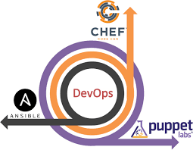
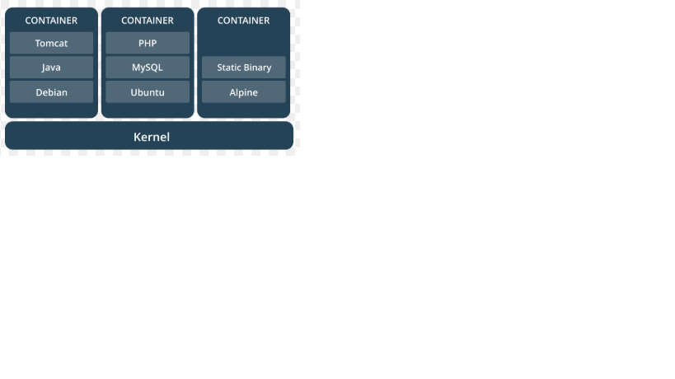
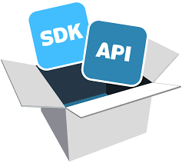

Suggestion & Recommendations
Migration Studio supports Cloud to Cloud, Virtual to Cloud, Storage to Cloud, Application to Cloud, Database to Cloud migration.
Baidu supports Storage to Cloud, Application to Cloud and Database to Cloud Services. In Database to Cloud Migration, there is scope for MSSQL, MySQL and PostgreSQL database migration on Baidu cloud.
Database Services like MSSQL, MySQL, PostgreSQL can be migrated to Baidu cloud.
Baidu has 718 APIs out of which 330 SDK’s are implemented.
There is implementation scope of further 338 SDKs which is 55% of the remaining SDKs.
SDK/API
Migration Studio
Contianer ShiftM, DockM
DevOps
`
Ansible – We can implement 737 Interfaces
Terraform – We can implement Interfaces for 718 APIs
Chef – We can implement Interfaces for 718 APIs for Baidu.
Baidu can use ShiftM, DockM application of Click2Cloud that provides lightweight management UI which allows you to easily manage your different Docker environments like Docker hosts or Swarm clusters and provides the kubernetes Dashboard.

